Slide 1
Riley County Community Health Improvement
Planning Meeting
January 29, 2015

Slide 2
Welcome from
Riley County Commission

Slide 3
Value of Health Planning Process and Community Input
Mercy Regional Health Center
Mercy has a long history of conducting community health needs assessments in order to identify priority health needs and adopt related implementation strategies to address those needs of those we serve. These assessments help us understand our patients.
Community meetings provide the opportunity for citizens to communicate directly with local public health agencies, health and social service organizations, and other community stakeholders to accelerate community health improvement.
A large component of the mission of Mercy is to “serve as a healing presence with special concern for our neighbors who are vulnerable.” We are grateful to collaborate with local agencies in order to better serve the needs of this community and embrace the social responsibility to those in need.

Slide 4
Value of Health Planning Process and Community Input
Riley County Health Department
  Today’s meeting and upcoming public meetings provide an opportunity for us to review the assessment results collected the last year and, as a community, identify and prioritize our most important health needs
  The Department uses the Public Health Accreditation Board’s standards and measures as the framework for quality public health services. This voluntary national accreditation program requires a community health assessment, a community health improvement plan, and an agency strategic plan to guide our work

Slide 5

Aligning Assessments Efforts
Comprehensive Community Needs Assessment
April 2014 – November 2014
Planning Committee
Riley County Senior Services Center*
Local Public Health Systems Performance
November 2013 – August 2014
Planning Committee
Riley County Board of Health
Riley County Health Department
Envisage Consulting, Inc.*
Community Partners
*Funding approved by the Riley County Board of Health
Community Health Improvement Plan
October 2014 – April 2015
Planning Committee
Riley County Health Department*
Mercy Regional Health Center
Riley County Seniors’ Service Center
Konza United Way
First United Methodist Church
Community Partners
*Funding approved by the Riley County Board of Health
**Funding for this project provided by a grant from the Kansas Health Institute (Accreditation Readiness Mini-Grant)
Mercy Regional Health Center**
Riley County Council on Aging**
Riley County Health Department
United Way of Riley County**
And more than 50 community partners
**A project made possible with funding from the Caroline Peine Foundation Charitable Foundation (Manhattan Fund) and the above.
*Coordinated by RCSSC in cooperation with the Center for Community Support & Research, Wichita State University.

Slide 6

Comprehensive Community Needs Assessment
Key Partners
Project coordination provided by
Riley County
Seniors’ Service Center
Funding provided by:
Caroline F. Peine Charitable Foundation (Manhattan Fund)
Konza United Way
Mercy Regional Health Center
Riley County Council on Aging
Wamego Health Center
Conducted by Center for Community Support & Research
Wichita State University
Design Team Members:
Konza United Way
Mercy Regional Health Center
Riley County Health Department
Riley County Seniors’ Service Center

Slide 7
Comprehensive Community Needs Assessment
Purpose
Gather data and community input regarding 11 areas of interest related to quality of life in Riley County.
General Quality of Life
Physical Health (including physical activity, nutrition and tobacco use)
Mental Health
Social Issues
Children and Youth
Education
Aging
Housing
Transportation
Infrastructure
Economics and Personal Finance

Slide 8
Comprehensive Community Needs Assessment
Multi-Method Approach
Quantitative
Secondary Data Compilation
Provides broad representation of community conditions
Community Survey (April – May 2014)
Provides perceptions from large number of community members
Semi-Structured Key Informant Interviews (September 2014)
Provides explanation of and richness for survey results
Qualitative
Focus Groups (October 2014)
Provides input from persons who were under-represented in other methods

Slide 9
Participant Worksheet Instructions
Actively listen and take notes!

Slide 10
Demographic Overview

Slide 11
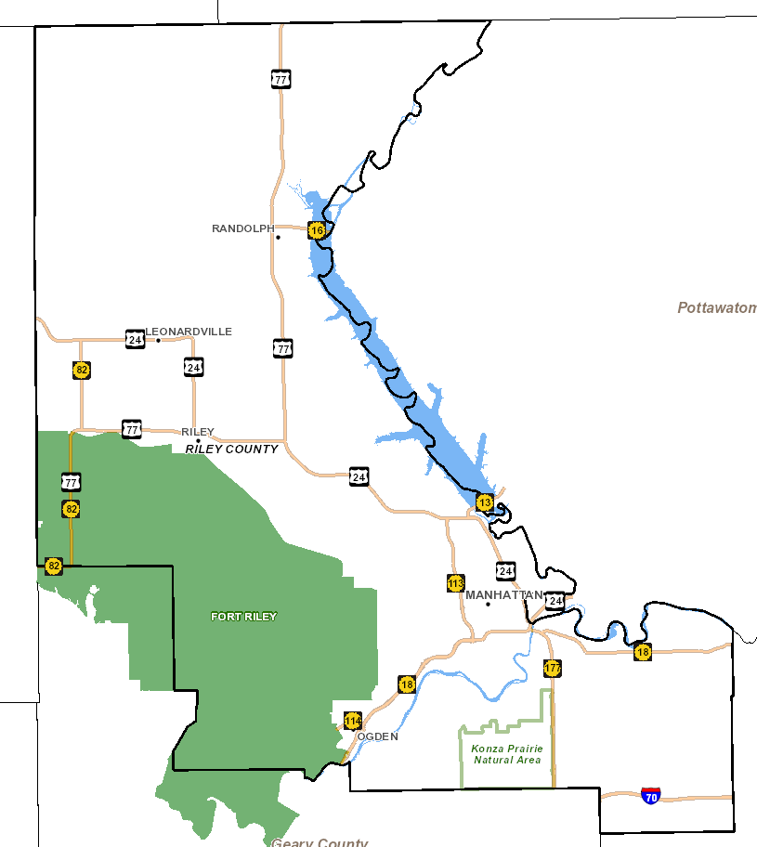
Notes:
2011-2013
Riley Co: 74,893
Manhattan: 55,483

Slide 13
* 2009 – 2013 ACS Census Estimates

Slide 14
* 2009 – 2013 ACS Census Estimates

Slide 15
Socioeconomic Overview

Slide 16
* 2009 – 2013 ACS Census Estimates

Slide 17
* 2009 – 2013 ACS Census Estimates

Slide 18
* 2009 – 2013 ACS Census Estimates

Slide 19
* 2009 – 2013 ACS Census Estimates
Notes:
1 person – about $12,000
2 people – about $16,000
Family of 4 with 2 adults and 2 children < 18 – about $24,000

Slide 20
* 2011 – 2013 ACS Census Estimates

Slide 21
* 2009 – 2013 ACS Census Estimates

Slide 22
Riley County Comprehensive Community Needs Assessment (CCNA)
Overview

Slide 23



“The overarching theme of the data collected is that Riley County is a community that is divided between a high quality of life, prosperity, and growth on one hand, and dwindling resources for and lack of attention to those who are most in need on the other.”
23

Slide 24
Overview of CCNA Findings
High quality of life
Growth
Spirit of community and collaboration
“Invisible” population with significant needs
Lack of accessible and affordable mental health services
Lack of affordable housing
Lack of accessible and affordable child care

Slide 25
Quality of Life
Riley County Comprehensive Community Needs Assessment

Slide 26

Quality of Life Findings
Percent respondents who “agree” or “strongly agree”
88% There are opportunities to volunteer in my community
87% This is a safe place to live
86% This is a good place to raise children
85% This is a beautiful place to live
82% I am satisfied with the quality of life in this community
41% I am satisfied with local government
39% All residents think that they can make the community a better place to live

Slide 27






Most Important Factors that Contribute to Quality of Life
Percent respondents who selected these among their top three:
33% Good schools
30% Good place to raise children
25% Clean environment
24% Safe neighborhoods
19% Healthy economy
18% Low crime

Slide 28
Physical Health
Riley County Comprehensive Community Needs Assessment

Slide 29





Top three needs related to physical health in your community?
Percent respondents who selected these among their top three:
34% Affordable health services
30% Affordable health insurance
29% Facilities for physical activity (including parks, trails, rec centers)
22% Increased health education/prevention
19% Affordable prescriptions
17% Access to healthy food options

Slide 30
Health Data from Secondary Sources (2013 data, unless otherwise indicated) | Kansas | Riley County
Percent adults with fair or poor self- perceived health status | 15.4% | 8.7%
Percent population without health insurance | 12.3% | 6.2%
Percent adults with hypertension | 31.3% | 18.9%
Percent adults tested and diagnosed with high cholesterol | 38.1% | 28.6%
Percent adults diagnosed with diabetes | 9.6% | 4.5%
Rate of age-adjusted cancer (all cancers, per 100,000, 2007-2011) | 21.1 | 15.5

Slide 31
Health Data from Secondary Sources (2013 data, unless otherwise indicated) | Kansas | Riley County
Percent adults who are obese | 30.0% | 20.7%
Percent adults living with a disability | 21.1% | 15.5%
Percent adults not participating in the recommended level of physical activity (aerobic and/or strengthening) | 82.1% | 73.4%
Percent adults reported consuming fruit less than one time per day | 41.7% | 44.6%
Percent adults consuming vegetables less than one time per day | 22.9% | 27.3%
Percent adults who currently smoke cigarettes | 20.0% | 19.8%

Slide 32
Mental Health
Riley County Comprehensive Community Needs Assessment

Slide 33



Top three needs related to mental health in your community?
Percent respondents who selected these among their top three:
40% Affordable mental health services
36% Affordable health insurance that includes mental health
32% High quality mental health services
28% Increased mental health education/prevention
27% Increased number of mental health providers

Slide 34
Data from Secondary Sources (2013 data, unless otherwise indicated) | Kansas | Riley County
Percent of adults reporting that mental health was not good on 14 or more days in the past 30 days | 9.7% | 9.8%
Percent of adults ever diagnosed with a depressive disorder | 18.1% | 23.9%

Slide 35
Social Issues
Riley County Comprehensive Community Needs Assessment

Slide 36

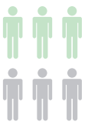

Top three social issues that are of most concern in your community?
Percent respondents who selected these among their top three:
27% Inattentive driving
27% Drinking and driving
26% Poverty
24% Youth drug or alcohol use
19% Mental illness
18% Adult drug or alcohol use

Slide 37

Top three needs related to social issues in your community?
Percent respondents who selected these among their top three:
34% Availability of services for people with low incomes
26% Positive activities for youth
25% Availability of employment
22% Availability of mental health services
20% Child care

Slide 38
Data from Secondary Sources (2012 data, unless otherwise indicated) | Kansas | Riley County
Percent of persons with food insecurity | 15.0% | 16.2%
Percent of adults who are binge drinkers (2013) | 15.4% | 24.4%

Slide 39
Children and Youth
Riley County Comprehensive Community Needs Assessment

Slide 40



Top three needs related to children in your community?
Percent respondents who selected these among their top three:
23% Child care for children 0-5
23% Financial assistance to families (for nutrition, child care, housing, etc.)
22% After school programs
18% Parenting education/skills development
17% Recreational activities

Slide 41

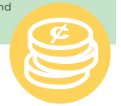
Top three needs related to youth in your community?
Percent respondents who selected these among their top three:
21% Employment opportunities for teens
18% Opportunities to contribute to the community
17% Financial skills training
15% Recreational activities
14% Bullying/relationship violence prevention
14% Appropriate internet/technology use

Slide 42
Data from Secondary Sources (2012 data, unless otherwise indicated) | Kansas | Riley County
Percent of births with inadequate prenatal care | 11.7% | 13.4%
Percent of premature births (2010 – 2012) | 8.9% | 8.1%
Infant mortality rate (2009 – 2013) | 6.4 | 6.2

Slide 43
Education
Riley County Comprehensive Community Needs Assessment

Slide 44

Top three needs regarding education in your community?
Percent respondents who selected these among their top three:
35% Getting and keeping good teachers
18% Increased parental involvement
16% Increased expectations for student achievement
16% Equality in funding among school districts
In general, respondents rated the quality of schools and teachers very high.

Slide 45
Aging
Riley County Comprehensive Community Needs Assessment

Slide 46


Top three needs for older adults in your community?
Percent respondents who selected these among their top three:
22% Affordable housing
19% Independent living at home
16% Transportation
13% Ease of mobility in the community
13% Affordable prescriptions

Slide 47
Housing
Riley County Comprehensive Community Needs Assessment

Slide 48



Top three needs related to housing in your community?
Percent respondents who selected these among their top three:
52% Affordable housing
26% Assistance with property repair and maintenance
26% Higher quality rentals
24% Code enforcement
20% Neighborhood improvement programs

Slide 49
Transportation
Riley County Comprehensive Community Needs Assessment

Slide 50

Top three transportation-related needs in your community?
Percent respondents who selected these among their top three:
40% Improve public transit service
32% Develop a pedestrian-friendly transportation system to make areas more walkable
31% Provide maintenance and improvements to existing facilities
28% Expand and improve the bike route system
26% Address texting and driving

Slide 51
Data from Secondary Sources (2013 data, unless otherwise indicated) | Kansas | Riley County
Percent adults who reported they do not always wear a seatbelt when they drive or ride in a car | 17.0% | 12.3%
Age-adjusted traffic injury mortality rate (2010-2012 per 100,000) | 14.8 | 5.1

Slide 52
Infrastructure
Riley County Comprehensive Community Needs Assessment

Slide 53




How would you rate the following public services/features?
Highest rated services:
Library facilities
Fire department
Emergency services
Air quality
Clean environment
Lower rated services (still averaged fair-good):
Paths/safe options for biking and walking
Code enforcement for private properties
Road maintenance

Slide 54
Economics and Personal Finance
Riley County Comprehensive Community Needs Assessment

Slide 55


Top three economic/personal finance needs in your community?
Percent respondents who selected these among their top three:
36% Availability of jobs
21% Emergency assistance to individuals or families
21% Assistance with searching for and gaining employment
20% Small business development
19% Low-cost resources to help with personal finance management

Slide 56
Review of Key Findings
Riley County Comprehensive Community Needs Assessment

Slide 57
“The overarching theme of the data collected is that Riley County is a community that is divided between a high quality of life, prosperity, and growth on one hand, and dwindling resources for and lack of attention to those who are most in need on the other.”
57

Slide 58
Overview of CCNA Findings
High quality of life
Growth
Spirit of community and collaboration
“Invisible” population with significant needs
Lack of accessible and affordable mental health services
Lack of affordable housing
Lack of accessible and affordable child care

Slide 59
Local Public Health Systems Assessment

Slide 60
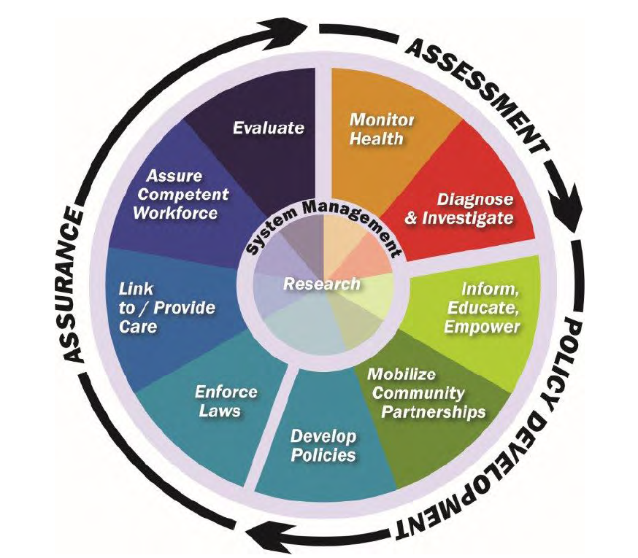
Local Public Health Systems Assessment (LPHSA)
What is public health? Activities that society undertakes to assure the conditions in which people can be healthy.
  The public health system is more than the public health agency…it involves all public and private entities that contribute to public health and the health and well-being of a community.
10 Essential Public Health Services provided the framework for the assessment instrument
10 services and related “model standards” describe an optimal level of performance and capacity
Approximately 100 people participated in the assessment in June 2014
See report for detailed description of scoring instrument, process, and results

Slide 61
Local Public Health System Assessment (LPHSA) Results
Overall, the Riley County Public Health System scored very favorably
No essential services performed in the “No Activity” (0%) or “Minimal Activity” (1-25%) range.
Six essential services averaged in the “Moderate Activity” (26-50%) range:
    ES 9: Evaluate Services (35.0%)
    ES 8: Assure Workforce (36.9%)
    ES 10: Research/Innovations (38.2%)
    ES 3: Educate/Empower (38.9%)
    ES 5: Develop Policies/Plans (45.8%)
    ES 1: Monitor Health Status (47.2%)
Three essential services performed in the “Significant Activity” (51-75%) range:
    ES 4: Mobilize Partnerships (54.2%)
    ES 7: Link to Health Services (59.4%)
    ES 6: Enforce Laws (66.7%)
One essential services performed in the “Optimal Activity” (76-100%) range:
    ES 2: Diagnose and Investigate (95.8%)

Slide 62

Overall LPHSA Observations
Much work is being done (lots of resources, lots of organizations, doing a lot of good things)…but many (including community leaders, providers, organizations, and the public) don’t know about it
Some essential services are lacking a central authority or lead organization to take fully implement or utilize resources in an intentional, coordinated way
Need for increased communication, coordination, and linkages within the local public health system
  Know who offers services and resources
  Improve linkages of clients to needed health and social services
  Bridge gaps/improve partnerships among organizations
Need to expand local public health system’s ability to share and use data and informational resources
  Multiple “resource guides”
  A lot of data, but not all of it is regularly/fully utilized by the LPHS and its constituents
  Data is not completely accessible and in one place

Slide 63
Overall LPHSA Observations
Concerns related to mental health
Contributing to awareness and coordination challenges: communities beyond Manhattan geographically spread out and somewhat disconnected, transient population and workforce, independently resourceful organizations
General lack of awareness of the 10 essential services and the public health system, as well as how a strong public health system benefits the community
Need more direct and broad-based involvement of local public health systems representatives in community meetings and decision-making processes

Slide 64
Facilitated
Small Group Discussion
Each group submits top three health needs for voting

Slide 65
Large Group Voting –
Distribute your 6 dots (votes) in any way you choose

Slide 66
Upcoming Community Meetings for Public Input
Please help publicize and consider attending!
Sunday, February 8
Manhattan
2-3:30pm
Wednesday, February 25
Keats
7:30-8:30pm
Thursday, February 12
Manhattan
1-2:30pm
Sunday, March 1
Leonardville
2:00-3:30pm
Wednesday, February 18
Riley
6:30-8:00pm
Monday, March 2
Randolph
12:00-1:00pm
Tuesday, February 24
Ogden
6-7:30pm
Wednesday, March 4
Randolph
7:00-8:00pm

Slide 67
Resources
Riley County Community Health Improvement Planning process and meetings:
datacounts.net/rcchip/
Riley County Comprehensive Community Needs Assessment Results:
www.rileycountycommunityneedsassessment.org
Riley County Local Public Health System Assessment Results:
datacounts.net/lphsa/

Slide 68
Thank you!

